Slide 1

Data Science Capstone Project
Berat Hamança
https://github.com/Hamancab
01/03/2025

Slide 2
Presentation Outline
This presentation will cover the entire project. It includes the executive summary and introduction. We'll also discuss methodology and results.
1
Executive Summary
2
Introduction
3
Methodology
4
Results
5
Conclusion
6
Appendix

Slide 3

Executive Summary
Data was gathered from the SpaceX API and Wikipedia. A 'class' column was created to label landings. The data was analyzed with SQL and visualizations.
Four machine learning models were tested. They predicted successful landings with ~83% accuracy. More data will improve model accuracy.
Data Collection
Data Exploration
API and web scraping.
SQL, visualization, maps.
ML Models
83% accuracy.

Slide 4

Project Introduction
The era of commercial space travel has arrived, with SpaceX leading the way through cost-effective reusable rockets. To compete effectively, SpaceY requires a predictive model.
The goal of this project is to develop a model that predicts successful Stage 1 rocket recovery, enabling SpaceY to optimize costs and enhance their competitive edge. This model will be trained using available data and machine learning techniques.

Slide 5
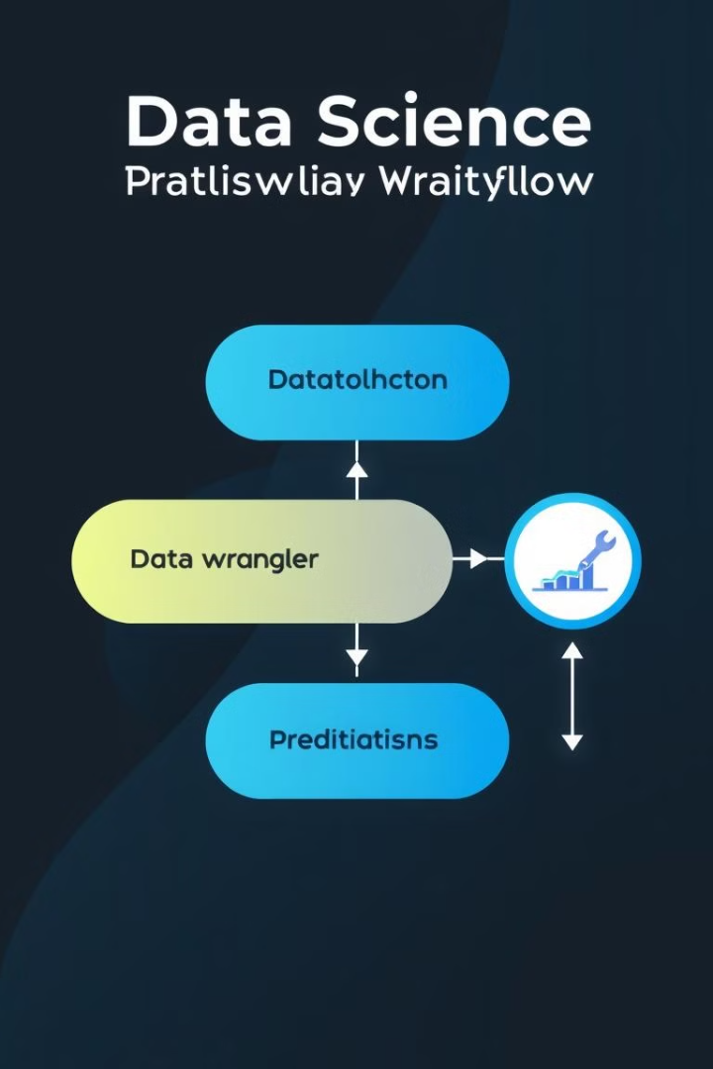




Methodology Overview
The methodology includes data collection and wrangling. Exploratory data analysis helps understand the data. Predictive analysis uses classification models.
Models were tuned using GridSearchCV. This ensures the best parameters for the model. This is a standard ML process.
Collect Data
Data Wrangling
EDA
ML Modeling

Slide 6




Methodology Details
The process had multiple steps. This included data collection, wrangling, and visualization. Dashboards and model methods are used to draw conclusions.
Wrangle
Visualize
Collect
Model
2
3
1
4

Slide 7


Data Collection
Data was collected from SpaceX API and Wikipedia. The API provided real-time launch data. Web scraping extracted historical launch details.
API data included specific launch details. Web data has additional booster information.
SpaceX API
Web Scraping

Slide 8





API Data Collection
The data collection process used the Space X API. Falcon 9 launches were specifically targeted.
Missing 'PayloadMass' values imputed with the mean. Data was normalized for analysis.
Request API
Filter Falcon 9
Impute Payload
Dictionary to DF

Slide 9





Web Scraping Collection
Web scraping extracted data from Wikipedia. BeautifulSoup and html5lib were used. The process iterated through table cells. Data was then extracted.
Request Wiki
Find Table
Iterate Cells
Cast to DF

Slide 10

Data Wrangling Process
A training label was created for landing outcomes. Successful landings were labeled as 1. Failures were labeled as 0.
The 'class' column indicates landing success. Mission outcome determines the class value.
1
Create Label
2
Map Outcomes

Slide 11

EDA with Data Visualization
Variables Analyzed:
Plots Used:
Flight Number
Flight Number vs. Payload Mass
Payload Mass
Flight Number vs. Launch Site
Launch Site
Payload Mass vs. Launch Site
Orbit
Orbit vs. Success Rate
Class
Flight Number vs. Orbit
Year
Payload vs Orbit
Success Yearly Trend
Exploratory Data Analysis was performed to compare relationships between variables and determine their suitability for training the machine learning model, using scatter plots, line charts, and bar plots.

Slide 12

EDA with SQL
1
Data Loading
Loaded dataset into IBM DB2 Database.
2
SQL Python Integration
Queried using SQL Python integration.
3
Dataset Understanding
Queries were made to get a better understanding of the dataset.
4
Information Retrieval
Queried information about launch site names, mission outcomes, various payload sizes of customers, booster versions, and landing outcomes.

Slide 13

Interactive Map with Folium
Launch Site Visualization
Folium maps mark Launch Sites, successful and unsuccessful landings.
Visualizes successful landings relative to location.
Proximity Analysis
Shows proximity to key locations: Railway, Highway, Coast, and City.
Understand why launch sites may be located where they are.

Slide 14

Build a Dashboard with Plotly
Dashboard includes a pie chart and a scatter plot.
Pie chart can be selected to show distribution of successful landings across all launch sites and can be selected to show individual launch site success rates.
Scatter plot takes two inputs: All sites or individual site and payload mass on a slider between 0 and 10000 kg.
The pie chart is used to visualize launch site success rate.
The scatter plot can help us see how success varies across launch sites, payload mass, and
booster version category.
GitHub url:

Slide 15
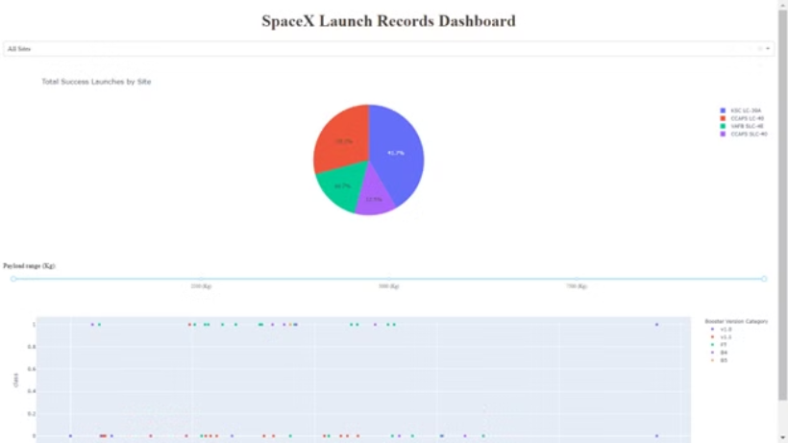
Predictive analysis (Classification)
This is a preview of the Plotly dashboard. The following sides will show the results of EDA with visualization, EDA with SQL, Interactive Map with Folium, and finally the results of our model with about 83% accuracy.

Slide 16


EDA with Visualization
Successful Launch
Unsuccessful Launch
Green indicates successful launch
Purple indicates unsuccessful launch

Slide 17
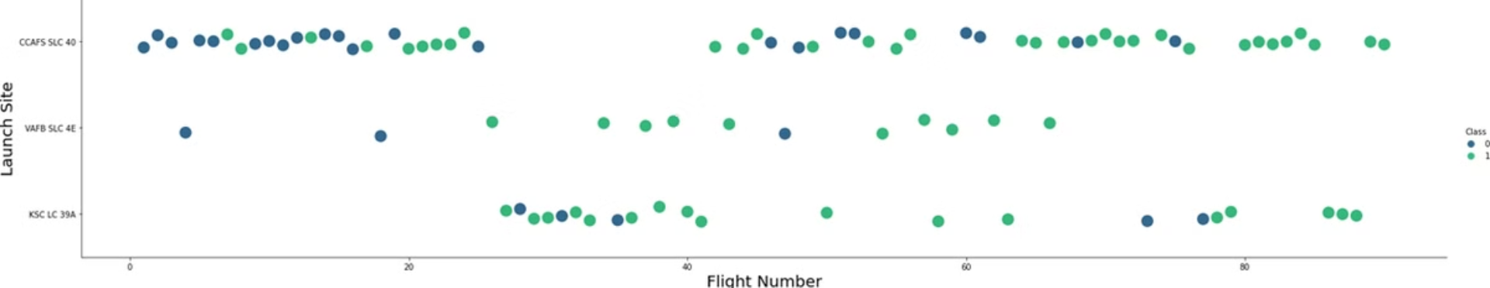
Flight Number vs. Launch Site
Green indicates successful launch; Purple indicates unsuccessful launch.

Slide 18
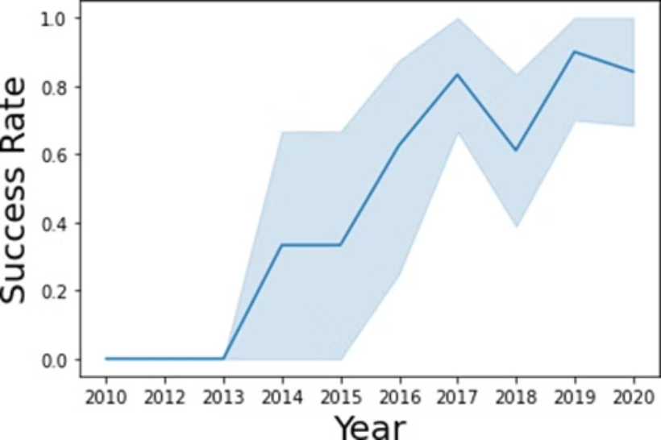
Launch Success Yearly Trend
95% confidence interval (light blue shading)

Slide 19
EDA with SQL

Slide 20
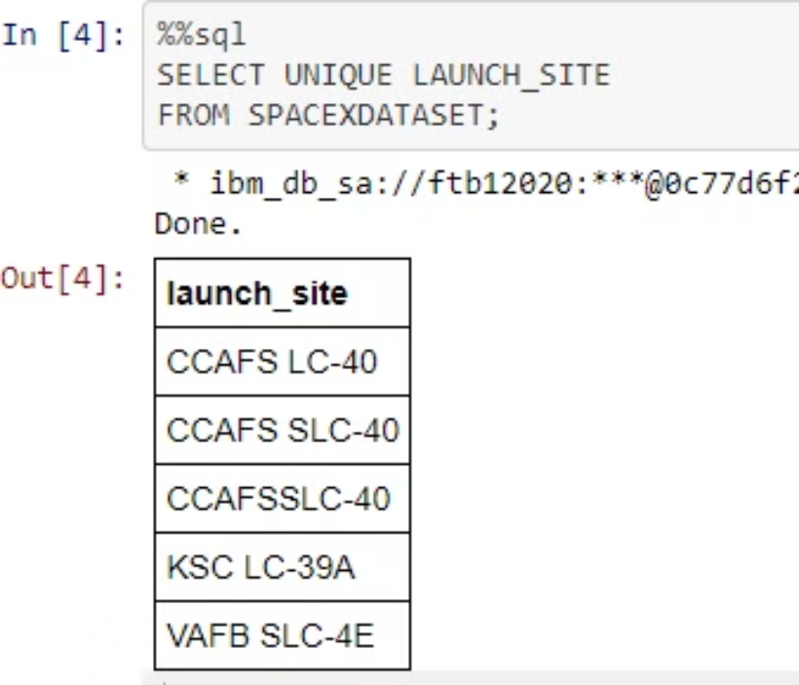
All Launch Site Names
unique launch site names from database.
CCAFS SLC-40 and CCAFSSLC-40 likely all represent the same
launch site with data entry errors.
CCAFS LC-40 was the previous name. Likely only 3 unique launch_site values: CCAFS SLC-40, KSC LC-39A, VAFB SLC-4E

Slide 21
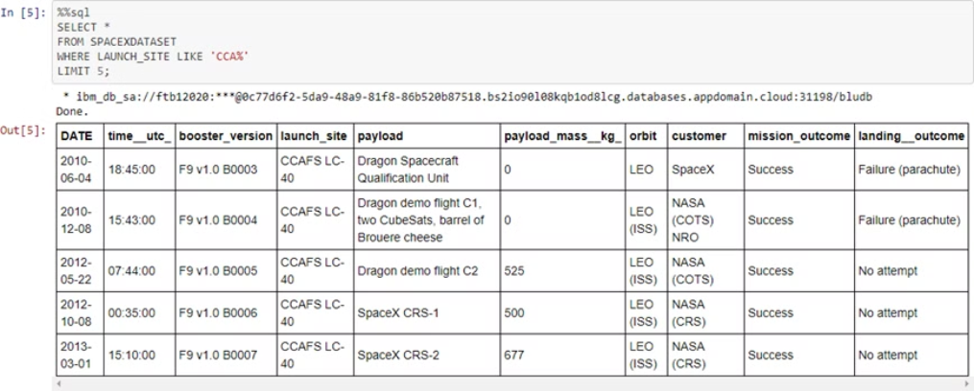
Launch Site Names Beginning with CCA
First five entries in database with Launch Site name beginning with CCA.

Slide 22
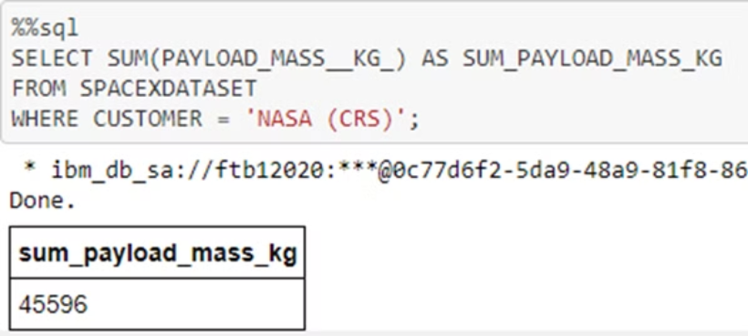
Total Payload Mass from NASA
This query sums the total payload mass in kg where NASA was the customer.
CRS stands for Commercial Resupply Services which indicates that these payloads were sent to the International Space Station (ISS).

Slide 23
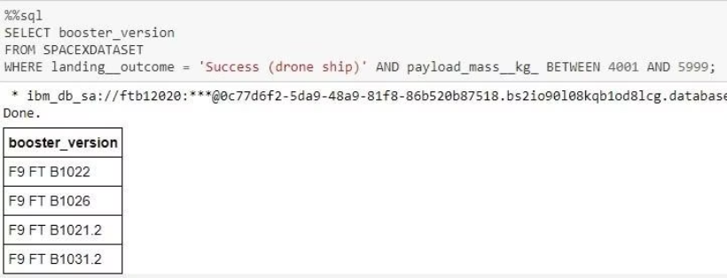
Successful Drone Ship Landing with Payload Between 4000 and 6000
This query returns the four booster versions that had successful drone ship landings and a payload mass between 4000 and 6000 noninclusively.

Slide 24
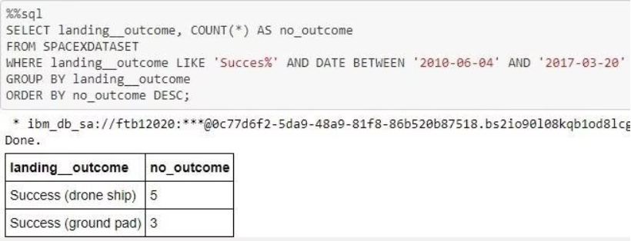
2015 Failed Drone Ship Landing Records
This query returns a list of successful landings and between 2010-06-04 and 2017-03-20 inclusively.
There are two types of successful landing outcomes: drone ship and ground pad landings.
There were 8 successful landings in total during this time period

Slide 25
Interactive Map with Folium

Slide 26
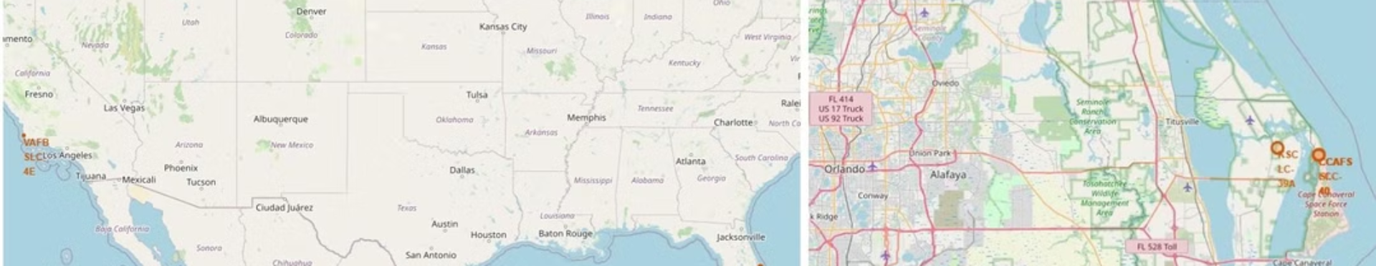
The left map shows all launch sites relative US map. The right map shows the two Florida launch sites since they are very close to each other. All launch sites are near the ocean.

Slide 27

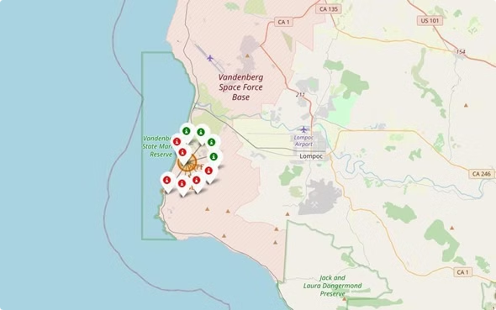
Color-Coded Launch Markers

Slide 28
Build a Dashboard with Plotly Dash

Slide 29

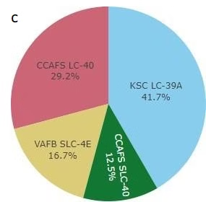
Successful Launches Across Launch Sites
This is the distribution of successful landings across all launch sites. CCAFS LC-40 is the old name of CCAFS SLC-40 so CCAFS and KSC have the same amount of successful landings, but a majority of the successful landings where performed before the name change. VAFB has the smallest share of successful landings. This may be due to smaller sample and increase in difficulty of launching in the west coast.

Slide 30

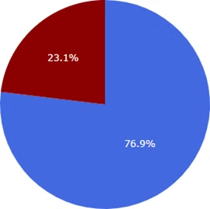
Highest Success Rate Launch Site
KSC LC-39A has the highest success rate with 10 successful landings and 3 failed landings.

Slide 31
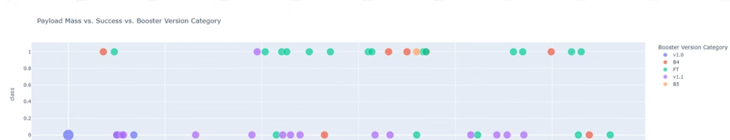
Payload Mass vs. Success vs. Booster Version Category
Plotly dashboard has a Payload range selector. However, this is set from 0-10000 instead of the max Payload of 15600. Class indicates 1 for successful landing and 0 for failure. Scatter plot also accounts for booster version category in color and number of launches in point size. In this particular range of 0-6000, interestingly there are two failed landings with payloads of zero kg.

Slide 32
Predictive Analysis (Classification)

Slide 33

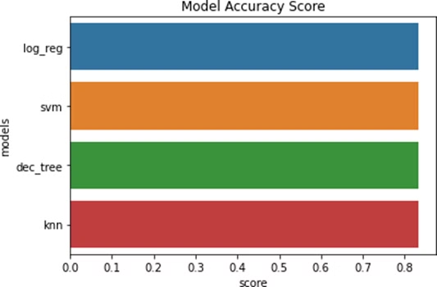
Classification Accuracy
models had virtually the same accuracy on the test set at 83.33% accuracy. It should be noted that test size is small at only sample size of 18.
This can cause large variance in accuracy results, such as those in Decision Tree Classifier model in repeated runs.
We likely need more data to determine the best model.

Slide 34

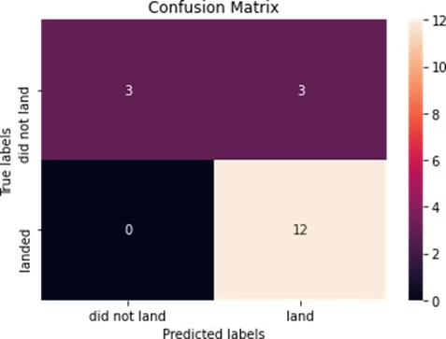
Confusion Matrix
Since all models performed the same for the test set, the confusion matrix is the same across all models. The models predicted 12 successful landings when the true label was successful landing.
The models predicted 3 unsuccessful landings when the true label was unsuccessful landing.
The models predicted 3 successful landings when the true label was unsuccessful landings (false positives). Our models over predict successful landings.

Slide 35
CONCLUSION
◦Our task: to develop a machine learning model for Space Y who wants to bid against SpaceX
◦The goal of model is to predict when Stage 1 will successfully land to save ~$100 million USD
◦Used data from a public SpaceX API and web scraping SpaceX Wikipedia page
◦Created data labels and stored data into a DB2 SQL database
◦Created a dashboard for visualization
◦We created a machine learning model with an accuracy of 83%
◦Allon Mask of SpaceY can use this model to predict with relatively high accuracy whether a launch will have a successful Stage 1 landing before launch to determine whether the launch should be made or not
◦If possible more data should be collected to better determine the best machine learning model and improve accuracy

